Slide 1
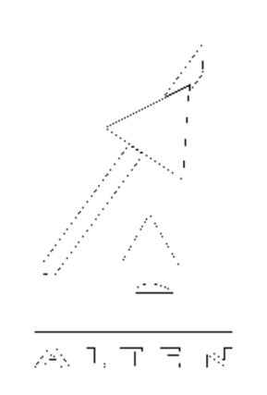



MONEYBALL
NEW SIZING RULES AND ALGORITHMS FOR UNMANNED LUNAR LANDERS
Conall DE PAOR
1st year PhD student
ISAE-SUPAERO, DCAS, SaCLaB
ALTEN SO
ANRT
Supervisors : Stéphanie LIZY-DESTREZ, Joan-Pau SANCHEZ-CUARTIELLES, Julien LAFFORGUE, Sebastien MAES
17/06/2025

Slide 2
Contents
Context – Why Size Unmanned Lunar Landers
Methods – Statistical Models and Sizing Algorithms
Results – Sizing Case Studies
Conclusion
17/06/2025

Slide 3
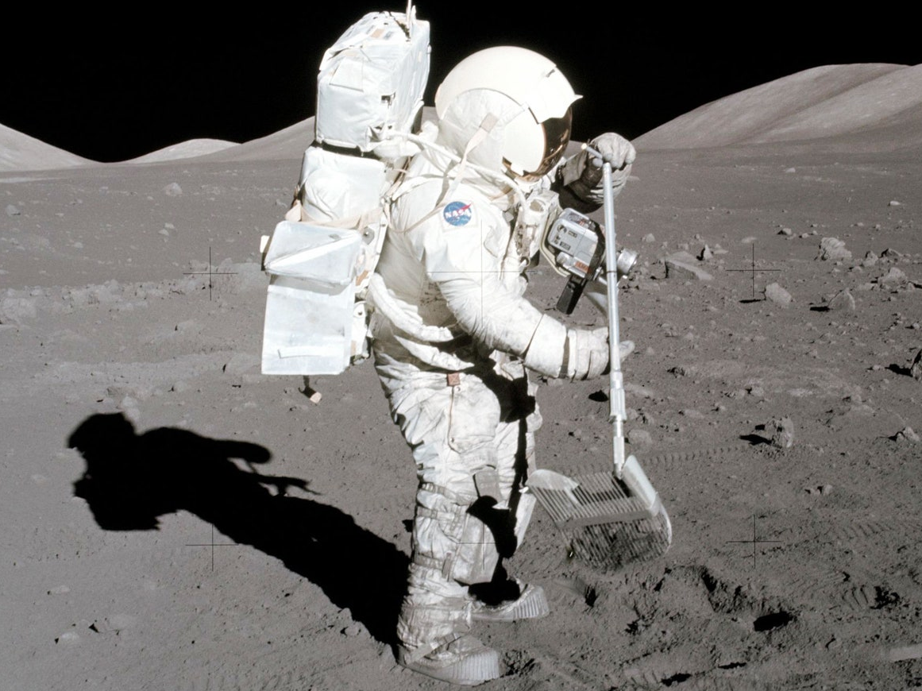
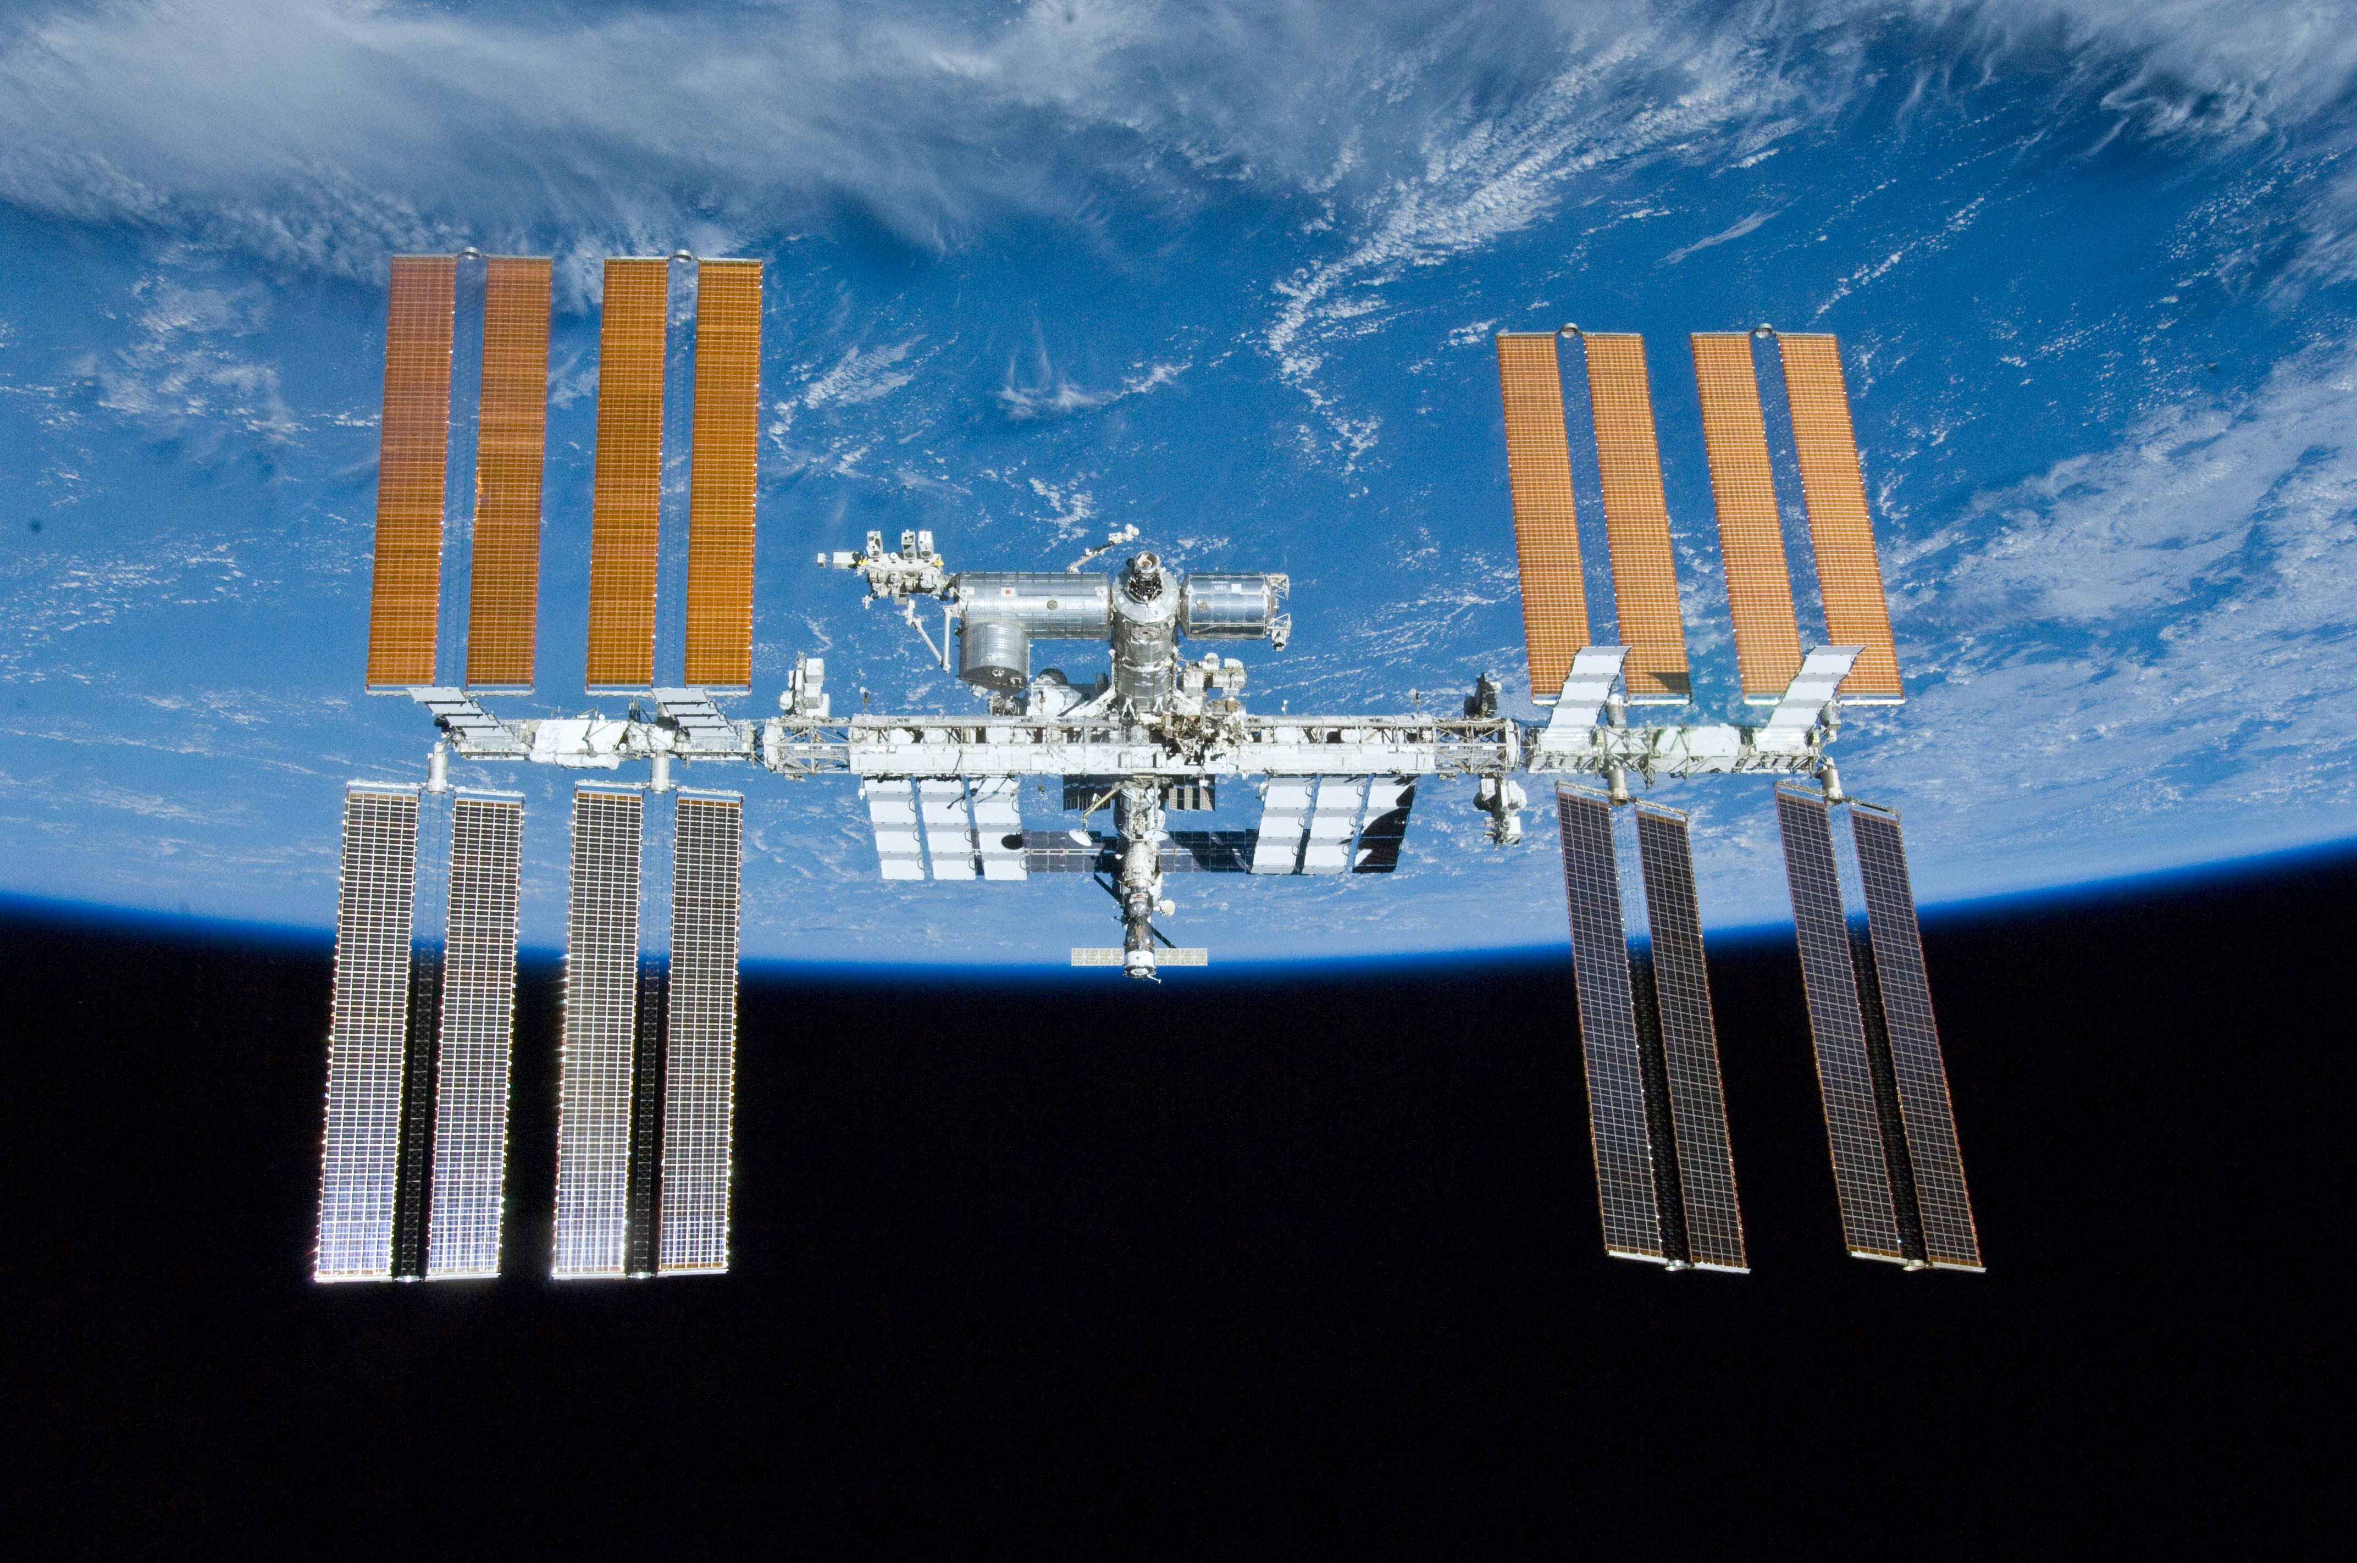
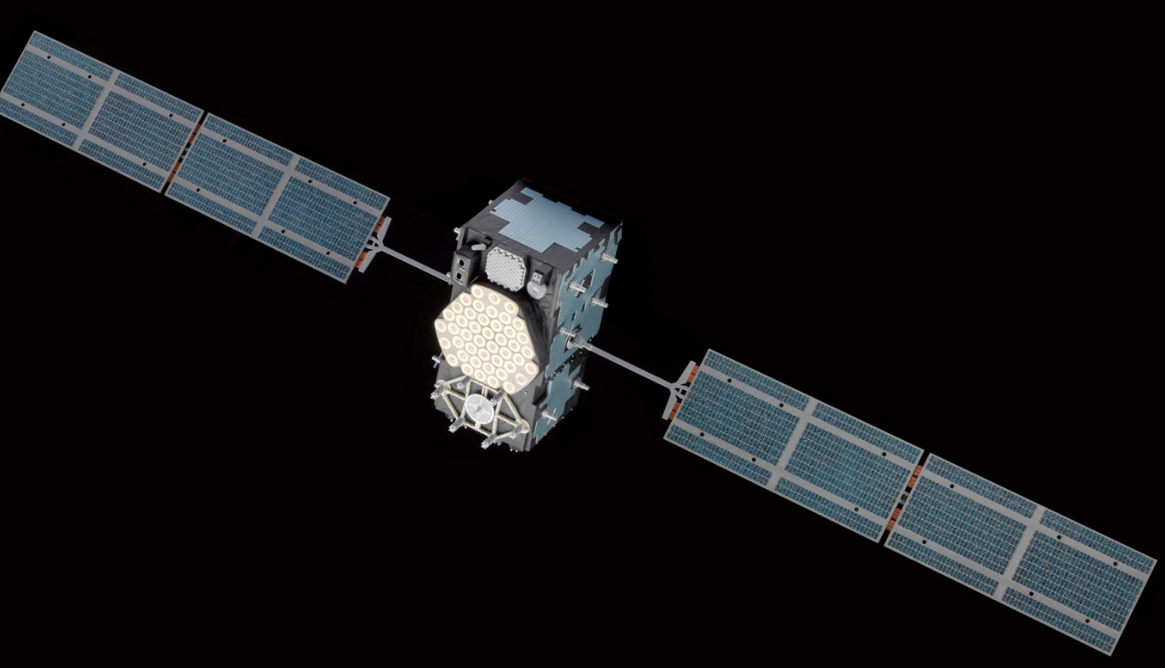
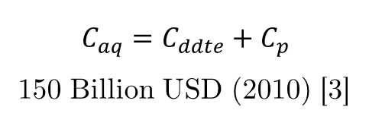
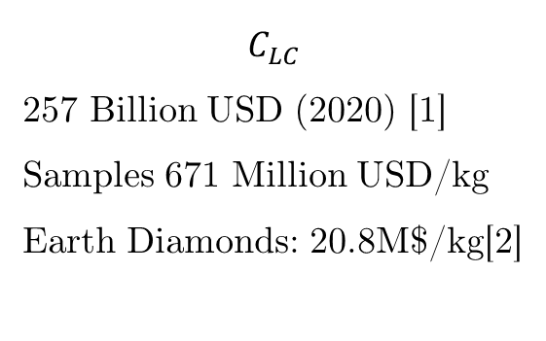
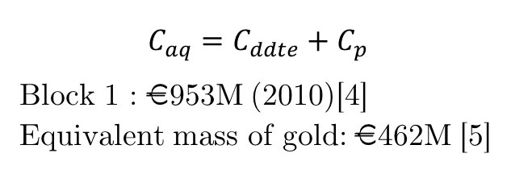
Context – The High Cost of Space Systems
A key variable: The Life Cycle Cost: $C_{LC}= C_{ddte}+C_{p}+C_{o}+C_{d}$
Galileo Constellation
Harrison Schmitt in 1972
International Space Station
$$C_{aq}=C_{ddte}+C_{p}$$
Block 1 : €953M (2010)[4]
Equivalent mass of gold: €462M [5]
$$C_{LC}$$
257 Billion USD (2020) [1] Samples 671 Million USD/kg Earth Diamonds: 20.8M$/kg[2]
$$C_{aq}=C_{ddte}+C_{p}$$
150 Billion USD (2010) [3]
To enable more like this, it needs to be cheaper
17/06/2025

Slide 4
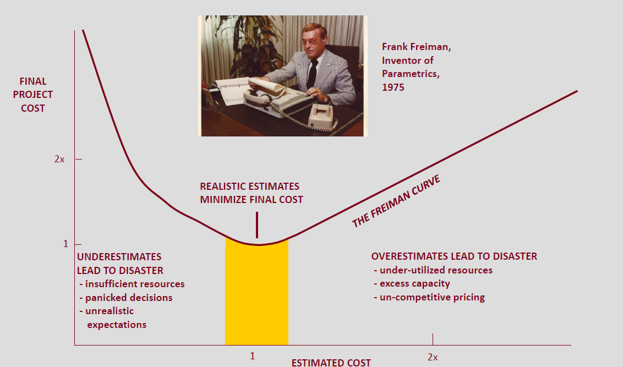
Context – The High Cost of Space Systems
A key to control costs: Estimate
Eilingsfeld F. Cost Engineering Lectures 2019 [3]
17/06/2025

Slide 5
Context – How to Estimate Cost and Why Size
Order of Magnitude Estimation
Component list
Parametric Cost Estimation Models (CEMs)
QuickCost
NAFCOM
Advanced Mission Cost Model
Small Spacecraft Cost Model
TruePlanning
All these CEMs require the mass properties of the (sub)system as an input
Even better at subsystem level
17/06/2025

Slide 6
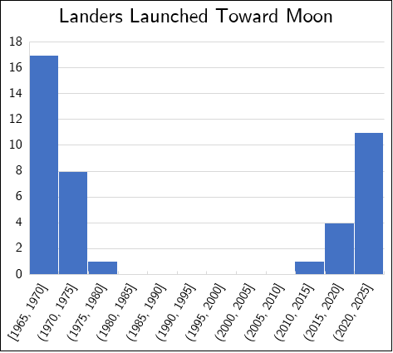
Context – Why Study Unmanned Lunar Landers
17/06/2025

Slide 7
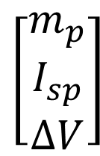
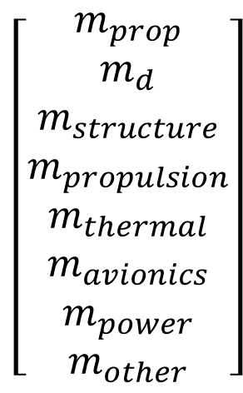
Current Topic – Mass Estimation of Lunar Landers
Study Objective:
$$\left[\begin{aligned}m_{prop} \\ m_{d} \\ m_{structure} \\ m_{propulsion} \\ m_{thermal} \\ m_{avionics} \\ m_{power} \\ m_{other}\end{aligned}\right]$$
$$\left[\begin{aligned}m_{p} \\ I_{sp} \\ ∆V\end{aligned}\right]$$
Lunar Lander
Sizing Algorithm
Cost estimation
Study case: lunar missions
17/06/2025

Slide 8
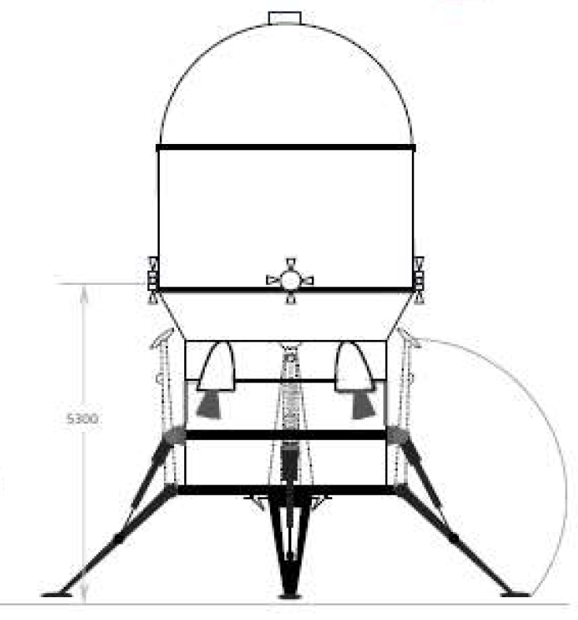
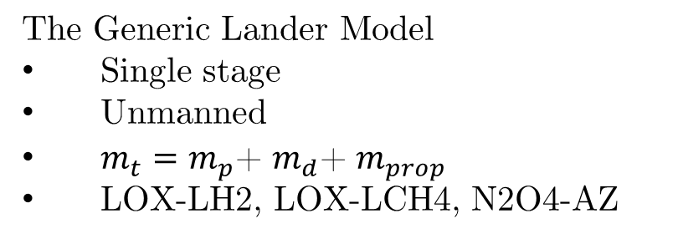

Methods – Statistical Models and Sizing Algorithms
Application case: Lunar Surface Missions
How to approach this mass estimation problem: Reference Models
The Generic Lander Model
Single stage
Unmanned
$m_{t}=m_{p}$+ $m_{d}$+ $m_{prop}$
LOX-LH2, LOX-LCH4, N2O4-AZ
The Generic Mission Model
Begin at LLO
Land on the surface with all payload
Return to LLO with some payload
Sets the delta-V
LLO
Avionics
Propulsion
Structure
Power
Thermal
Other
$$m_{d}$$
Surface
Phase
0
Orbit
1
approach
2
Descent & Landing
3
Payload deployment
4
Liftoff &
Orbit insertion
5
Orbit
17/06/2025

Slide 9
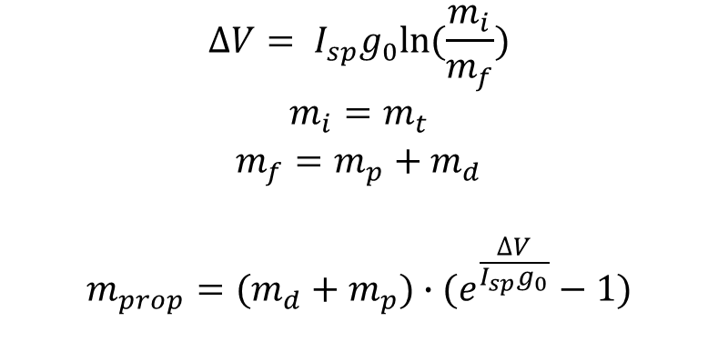
Methods – Statistical Models and Sizing Algorithms
First: for system level mass properties
$$∆V= I_{sp}g_{0}ln⁡(\frac{m_{i}}{m_{f}})$$
$$m_{i}=m_{t}$$
$$m_{f}=m_{p}+m_{d}$$
$$m_{prop}=(m_{d}+m_{p})∙(e^{\frac{∆V}{I_{sp}g_{0}}}−1)$$
known
Unknown
$m_{t}=m_{p}$+ $m_{d}$+ $m_{prop}$
Solution: find additional relations using statistics
17/06/2025

Slide 10
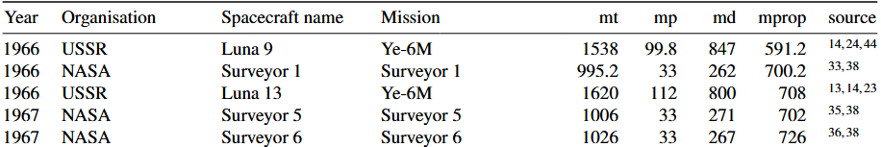
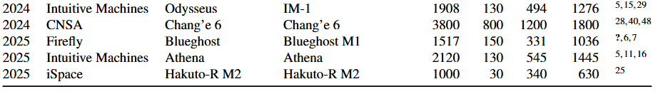
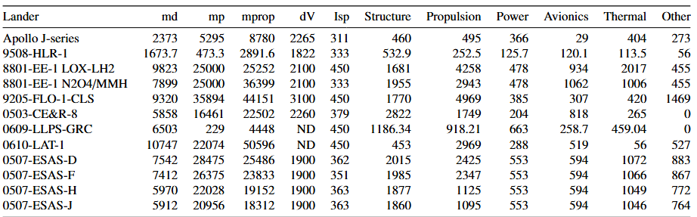







Methods – Databases
System masses DB (#35)
(Almost) all flight models
$$⋮$$
$$⋮$$
$$⋮$$
$$⋮$$
$$⋮$$
$$⋮$$
$$⋮$$
$$⋮$$
$$⋮$$
Subsystem masses DB (#12)
Flown landers and concepts
(payload for manned landers is ascent stage)
17/06/2025

Slide 11
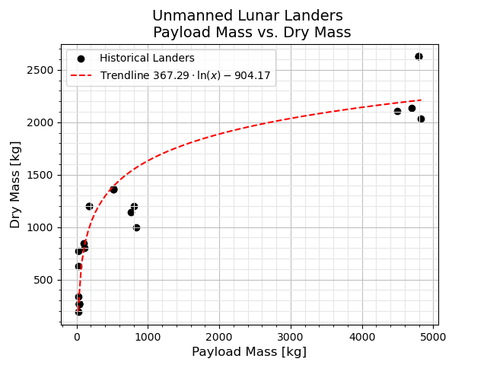
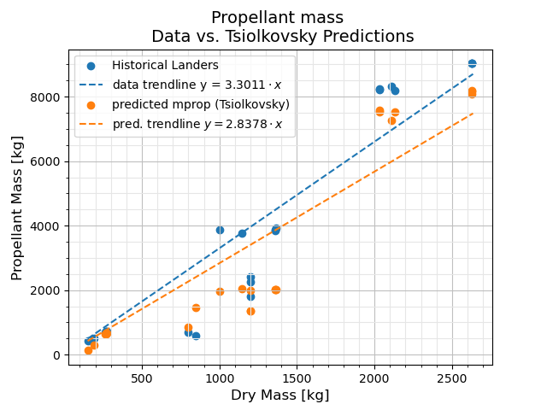


Results – Sizing Rules
For the system masses: $m_{d},\text{and} m_{prop}$
Dry mass + payload mass [kg]
$$m_{prop}=1.16∙(m_{d}+m_{p})∙(e^{\frac{∆V}{I_{sp}g_{0}}}−1)$$
$$m_{d}=367.29∙\ln\left(m_{p}\right)−904.17$$
$$R^{2}=0.92$$
17/06/2025

Slide 12
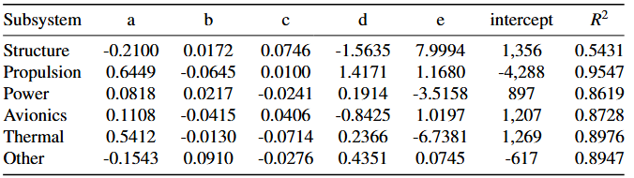
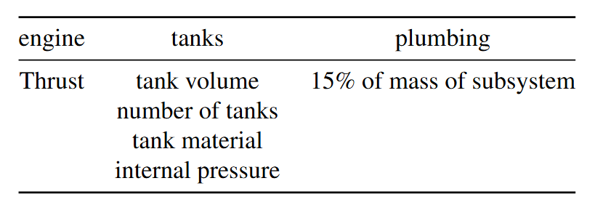
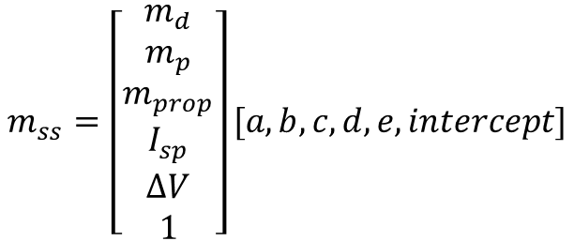
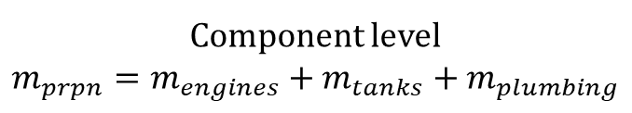
Results – Sizing Rules
For the subsystem masses: multiple linear regression, and bottom up sizing
$$m_{ss}=\left[\begin{aligned}m_{d} \\ m_{p} \\ m_{prop} \\ I_{sp} \\ ∆V \\ 1\end{aligned}\right][a, b, c, d,e, intercept]$$
Component level
$$m_{prpn}=m_{engines}+m_{tanks}+m_{plumbing}$$
Problems with outliers: Single linear regression used also
17/06/2025

Slide 13
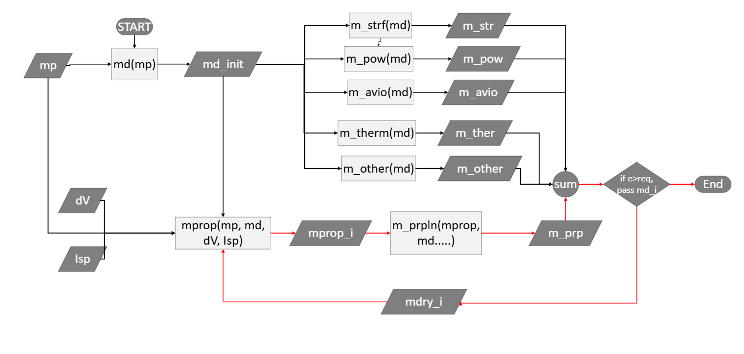
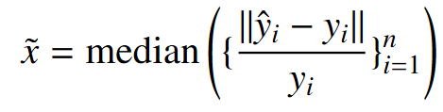
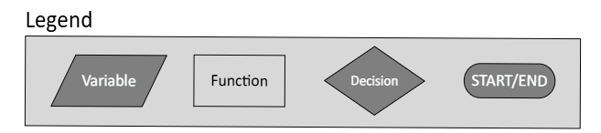
Sizing Algorithm
11 – Algorithms tested
Measured by median absolute error
17/06/2025

Slide 14
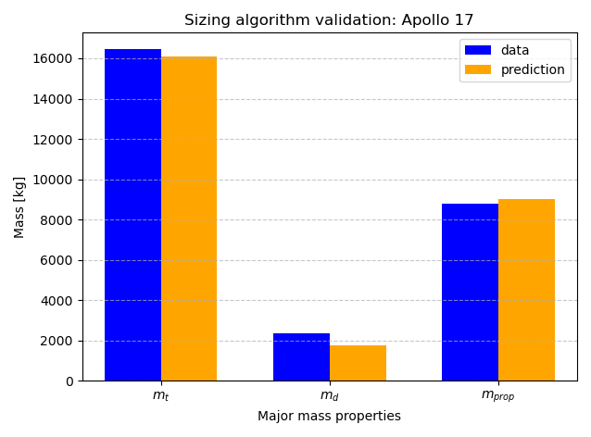
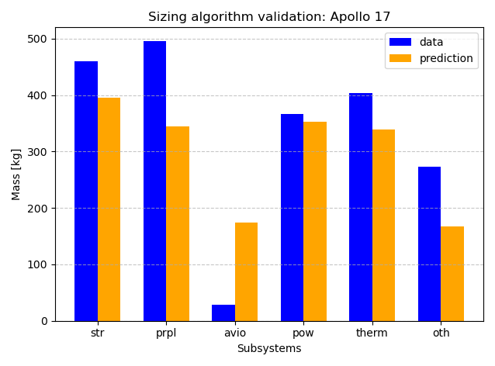
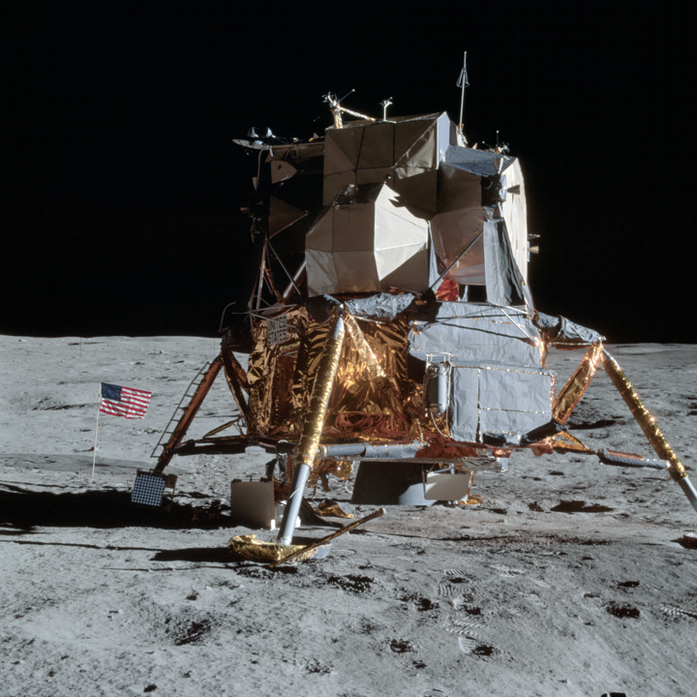
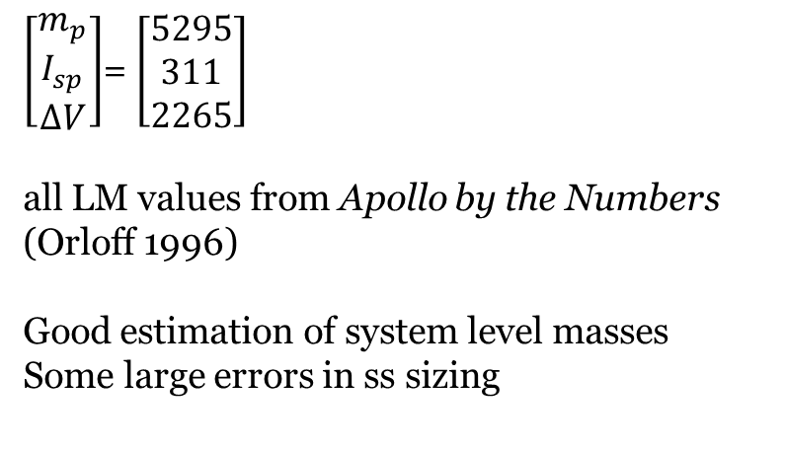
Results – Validation
Resizing of the J-series Apollo LM. Algo No. 7 N2O4/AZ
$\left[\begin{aligned}m_{p} \\ I_{sp} \\ ∆V\end{aligned}\right]$= $\left[\begin{aligned}5295 \\ 311 \\ 2265\end{aligned}\right]$
all LM values from Apollo by the Numbers (Orloff 1996)
Good estimation of system level masses
Some large errors in ss sizing
17/06/2025

Slide 15
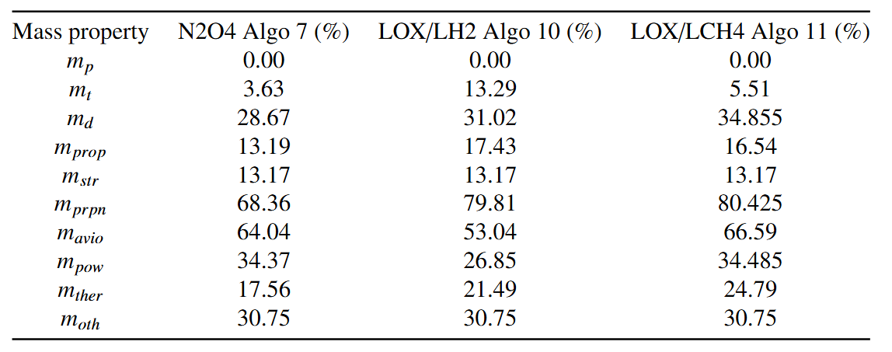
Results – Validation
Resizing all landers in the DB. The best performers: all single linear regressors
17/06/2025

Slide 16
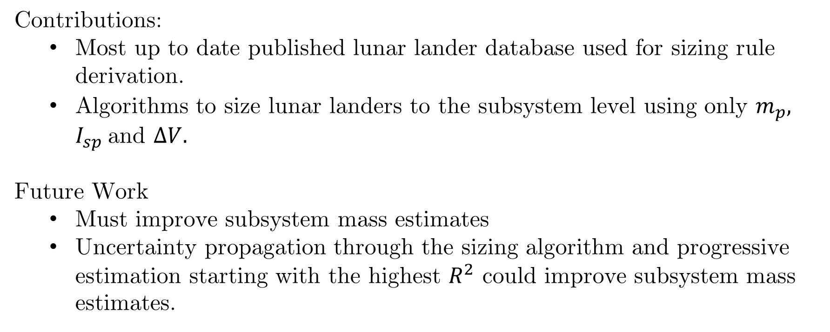
Conclusion
Contributions:
Most up to date published lunar lander database used for sizing rule derivation.
Algorithms to size lunar landers to the subsystem level using only $m_{p}, I_{sp}$and $∆V.$
Future Work
Must improve subsystem mass estimates
Uncertainty propagation through the sizing algorithm and progressive estimation starting with the highest $R^{2}$ could improve subsystem mass estimates.
17/06/2025

Slide 17
References
Amos, J., 2010. EU awards Galileo satellite‑navigation contracts. BBC News, 7 January. Available at: http://news.bbc.co.uk/2/hi/science/nature/8442090.stm]
StoneAlgo (2024) Diamond Prices – Real-Time Market Trends. Available at: https://www.stonealgo.com/diamond-prices/?srsltid=AfmBOooDezL1x8X3j9bA7wr0FFT2uVo1hgZrP4pOa6aAj3RQ3cCIizXn (Accessed: 28 May 2025).
Lafleur, C., 2010. Costs of US piloted programs. The Space Review, 8 March. Available at: [http://www.thespacereview.com/article/1579/1]
Amos, J., 2010. EU awards Galileo satellite‑navigation contracts. BBC News, 7 January. Available at: http://news.bbc.co.uk/2/hi/science/nature/8442090.stm]
GoldPrice.org, 2025. Gold Price Charts & Historical Data [online] Available at: https://www.goldprice.org/
F. Eilingsfeld, 2019 Introduction to Cost Engineering lecture 1.
17/06/2025

Slide 18
Thank you !
17/06/2025

Slide 19
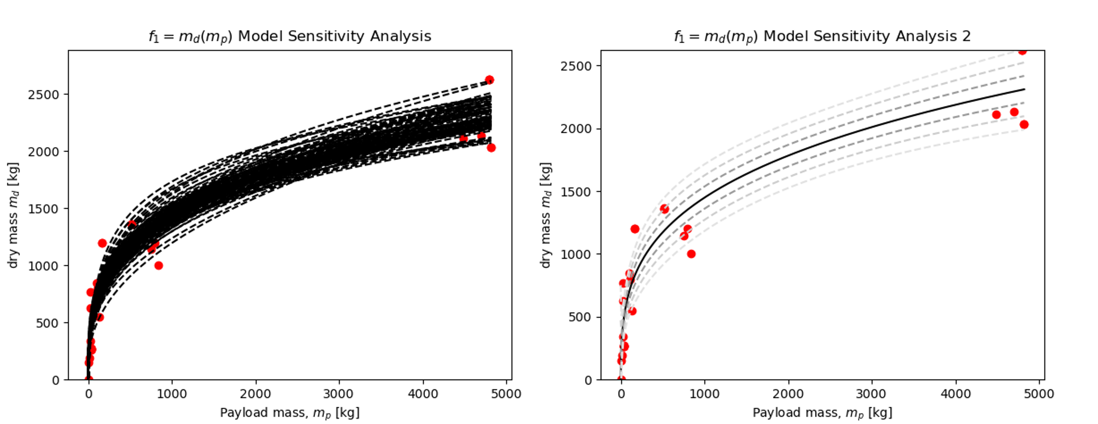
Extra slides – Uncertainty
17/06/2025

Slide 20
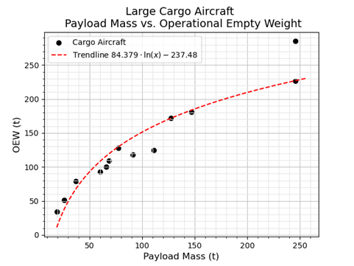
Extra slides Cargo Aircraft
17/06/2025

Slide 21
Extra Single Linear Regression
17/06/2025

Slide 22
Extra Single Linear Regression
17/06/2025

Slide 23
Extra Single Linear Regression
17/06/2025

